Slide 1
Machine learning CS 229 / stats 229

Slide 2


Introduction

Slide 3
Goals
By the end of the course,
Be an expert in ML (understand the internals of ML algorithms)
Be able to build ML applications (know which algorithms to use when)
Be able to start ML research (read research papers)

Slide 4
Prerequisites
Basic computer science principles
Big-O notation
Comfortably write non-trivial code in Python/numpy
Probability (CS 109, STATS 116 etc.)
Random Variables
Expectations
Distributions
Linear Algebra & Multivariate/Matrix Calculus (MATH 51, etc.)
Gradients and Hessians
Eigenvalue/vector

Slide 5
Honor code
Form study groups (strongly encouraged!)
Independently write-up homework and code
It is an honor code violation to intentionally refer to a previous year's assignments.

Slide 6
Course structure
3 Homeworks : 60% (3 x 20%)
Final exam (take home) : 40%

Slide 7
Logistics
Course website (calendar, deadlines, notes) - http://cs229.stanford.edu
Piazza
Gradescope

Slide 8
What is ml?
Term “Machine Learning” coined by Arthur Samuel in 1959.
Samuel Checkers-playing Program
Common definition (by Tom Mitchell):
Machine Learning is the study of computer algorithms that improve automatically through experience
Subfield of Artificial Intelligence (AI)
The hottest subfield - reinvigorated interest in AI due to deep learning!

Slide 9
Recent progress
Computer Vision / Image Recognition
ImageNet
Convolutional Neural Networks
Autonomous driving
Speech Recognition
Voice assistants
Language Translation
Google Translate
Unsupervised Translation
Game Playing / Deep Reinforcement Learning
ATARI
AlphaGo

Slide 10
Course Preview
Supervised learning [Input -> Output mapping]
Classification vs Regression
Parametric vs Non-parametric
Generative vs Discriminative
Probabilistic vs Non-probabilistic
Unsupervised learning [Learn interesting structures in the data]
Clusters vs Subspaces
Probabilistic vs Non-probabilistic
Deep Learning [Learning representations]
Our focus: supervised setting
Learning Theory
Bias-Variance Tradeoff
Generalization and Uniform Convergence
Reinforcement Learning [Sequential Decision Making]

Slide 11
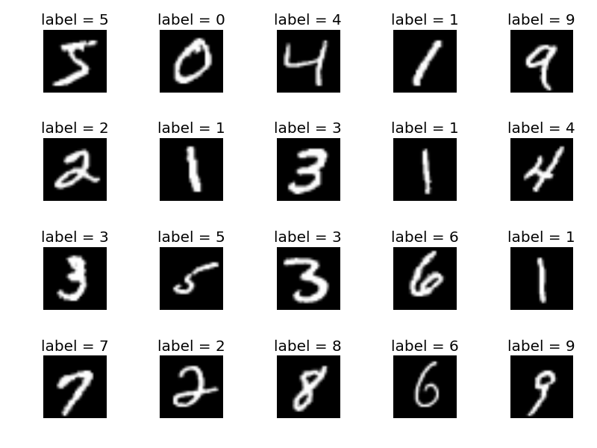
Preview - Supervised

Slide 12

PREVIEW – UNSUPERVISED (ICA)
Mixed
Separated

Slide 13
PREVIEW – UNSUPERVISED (ICA - II)
Mixed
Separated

Slide 14
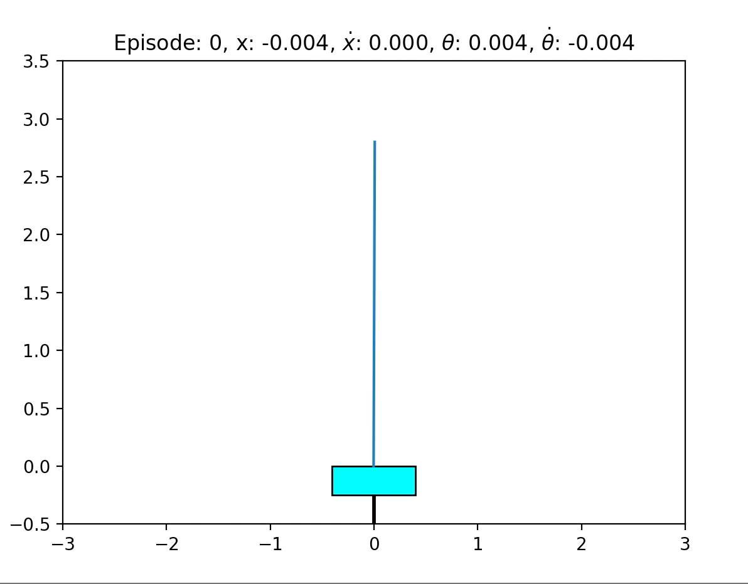
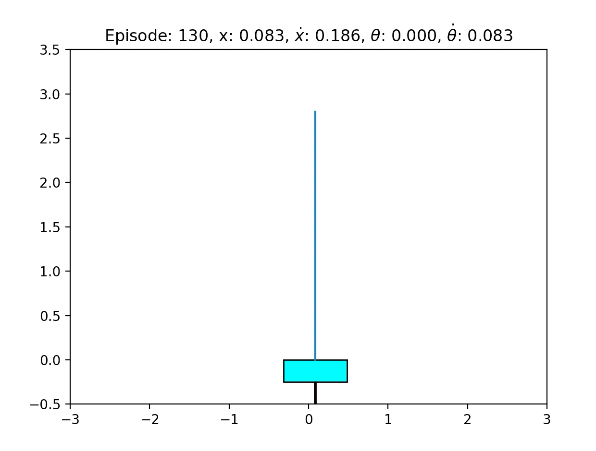
PREVIEW – REINFORCEMENT LEARNING

